Slide 1
RE Management
Source: Elizabeth Hull, Ken Jackson and Jeremy Dick, Requirements
Engineering , Second Edition, 2005

Slide 2
Introduction
Requirements management is a systematic approach to:
  eliciting, organizing, and documenting the requirements of the system, and
  establishing and maintaining agreement between the customer and the project team on the changing requirements of the system.

Slide 3
What we need to know?
the sorts of activities that must be undertaken.
whether there are any dependencies between
the activities, e.g. whether one activity can commence only when another one has been completed.
what kinds of skills are required to perform the activities.

Slide 4
Three Important Factors
Any project is constrained by three factors:
  product capability;
  cost; and
  time-scale.
These three factors are related.
Any change to one of these factors will have a consequential change to at least one of the others.

Slide 5
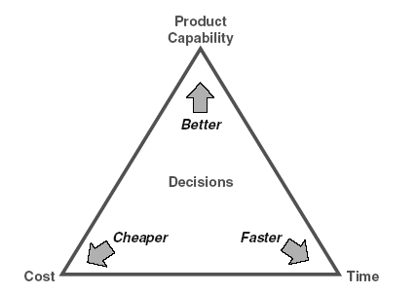
Three Important Factors

Slide 6
Three Important Factors – Contd…
The figure indicates that projects make progress by taking decisions.
Every decision positions the project with respect to these three fundamental factors.
Every project manager dreams that each decision will improve the product capability while simultaneously reducing cost and shortening development time.
In spite of its improbability, this dream is widely held.

Slide 7
Requirements Management Problems
Very few people have had significant experience of managing requirements.
  This is mainly because very few organizations have a defined requirements management process that is followed across the organization.
Many people do not properly distinguish between
user or stakeholder requirements and system requirements.
  Further, they often do not distinguish between system requirements and design specifications.

Slide 8
Req. Management Problems – contd ..
The way in which requirements are managed
will depend upon the type of organization in which the work is being done.
It is difficult to monitor progress when requirements are being generated.
  One difficult issue is to know whether the requirements set is complete.
The final problem is the perennial problem of changes.
  Any proposed change will usually relate to one or more requirements.

Slide 9
Specific management issues
Planning;
Monitoring progress;
Controlling changes.

Slide 10
Types of Organizations
Acquisition organizations: that purchase systems and then use them to provide an operational capability.
  These organizations are mainly concerned with creating and managing stakeholder requirements.
Supplier organizations: that respond to acquisition requests from acquisition organizations.
  These organizations receive input requirements and develop system requirements (and subsequently a design that is manufactured) in response to them.
Product companies: that develop and sell products.
  These organizations collect stakeholder requirements from their market place rather than from individuals or from operations organizations.

Slide 11
Managing Requirements in an Acquisition Organization
Planning
  the concept definition contains a “description of what the users want to be able to do”,
  identifying a fuller set of stakeholder types
  a more complete set of scenarios that cover
    the complete range of expected operation of the system including,
    where useful,
    different modes of operation.

Slide 12
Managing Requirements in an Acquisition Organization : Monitoring
Three major milestones help to define the monitoring :
  the definition of the structure for the requirements specification;
  the definition of the attributes required for each requirement;
  the definition of the review process(es) with associated checklists.

Slide 13
Managing Requirements in an Acquisition Organization : Monitoring – Contd…
Once the structure is in place, it is possible to determine whether there are any areas where there should be requirements but none exist.
These “holes” can be addressed by specific actions.
Once the attributes have been decided, progress in filling them can be monitored.
Finally, the progress against satisfying the review checklist criteria can be checked by measuring the number of requirements that have a specific status.

Slide 14
Managing Requirements in an Acquisition Organization : Changes
Important development stages include the following:
  Stakeholder requirements used as the basis for a competitive bidding process;
  Contract in place for the development of a system;
  Design, and manufacturing about to start;
  Acceptance trials are being undertaken;
  The system is in service.

Slide 15
Managing Requirements in an Acquisition Organization : Changes – Contd…
Whatever stage a project is at, the following steps are required in a change control process:
  record the suggested change;
  identify the impact of the suggested change;
  decide whether to accept the change;
  decide when to implement the change.

Slide 16
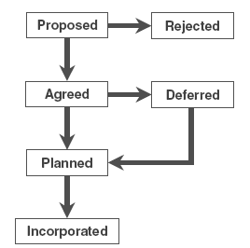
Managing Requirements in an Acquisition Organization : Changes – Contd…
State Transition Diagram for Change Control

Slide 17
Supplier Organizations
Supplier organizations respond to requests from customers to build systems or components for systems.
Prior to obtaining a contract to build a system, they must prepare a proposal to indicate how they intend to go about the job and containing estimates of cost and time to complete the work.
Supplier organizations are considered from two points of view:
  bidding for work; and
  executing a contract once

Slide 18
Bid Management - Planning
An invitation to tender (ITT), or request for proposal (RFP) will contain a set of requirements.
The nature of the requirements received will depend upon the customer organization.
If the customer is an acquisition organization it is likely that the requirements may be stakeholder requirements.
Alternatively, the customer may be another supplier organization that is planning to subcontract.
In this case the requirements are likely to be system requirements with imposed design constraints.

Slide 19
Bid Management – Planning Contd…
Whatever the nature of the input requirements received, they need to be:
  clearly identified;
  unambiguous;
  consistent;
  free from undue design constraints.

Slide 20
Bid Management – Planning Contd…
Review the input requirements, identify specific problems and propose a potential solution for them.
Possible options for each problem include:
  ignore it;
  make an assumption and document it;
  decide that it is essential to ask the customer whatever the consequences.

Slide 21
Bid Management – Monitoring
Measuring progress during the creation of a proposal is vital, because
  time-scales are usually constrained; and
  the submission date is not negotiable.
The end-point must be that the proposal clearly indicates how each input requirement will be met.
It is also necessary to state how a requirement will be met and check that all the declarations are valid.

Slide 22
Bid Management – Monitoring – contd…
A measure of the amount of outstanding work to be done can be obtained by:
  assessing the number of input requirements that still have outstanding problems logged against them; together with
  the number of input requirements that still have no proposed solution.

Slide 23
Bid Management – Monitoring – contd…
A measure of the quality of the system requirements must also be made.
This can be done by defining states and linking the progression through those states to review criteria.

Slide 24
Bid Management - Changes
During the preparation of a proposal there are three potential sources of change:
  customer;
  suppliers,
  internal.

Slide 25
Bid Management – Changes Contd…
Typically the probability of change is roughly proportional to the size of the system to be developed.
Suppliers often commence their bidding activities with an early draft of an RFP to get the bid team running and thinking along the right lines.
Later versions are issued at intervals and may contain significant changes.

Slide 26
Bid Management – Changes Contd…
The first task on receipt of a new version of the RFP (or its requirements) is to determine the nature and extent of the changes.
The changes must be related to the work already done; and
An assessment made of the new work and rework is necessary.

Slide 27
Bid Management – Changes Contd…
Changes from customers can also come via responses to queries from bidders.
These are usually well focused and can be assessed quite readily.

Slide 28
Bid Management – Changes Contd…
Changes instigated by suppliers may be in response to an initial request for a proposal to indicate that they cannot meet the requirements
as defined; or
The changes may come later in the process when the supplier discovers that what was originally thought to be possible turns out not to be.

Slide 29
Bid Management – Changes Contd…
Internal changes arise for much the same reasons as the suppliers’ changes.
Initial assumptions turn out to be invalid and therefore an alternative approach must be taken.

Slide 30
Bid Management – Changes Contd…
Whatever the source of the change, it is essential that the various requirements baselines are kept up-to-date, i.e.:
  input requirements;
  requirements placed on suppliers;
  assumptions and interpretations made within the bid team.

Slide 31
Development - Planning
The development stage of a project commences with an agreed contract based on the proposal submitted to the customer and modified during contract negotiations.
One important difference is that instead of producing a proposal, the proposal previously submitted may now be part of the input requirements.

Slide 32
Development - Planning Contd…
The information generated during development activities will depend on the nature of the development and may be done in two stages:
  Producing an abstract model; and
  Producing one or more potential design solutions.

Slide 33
Development - Planning Contd…
More than one solution needs a comparative assessment of the solutions.
This comparative assessment leads to the creation of options and the possibility of trading off some requirements against others.
This tradeoff may be done entirely internal to the supplier organization; or
It may involve the customer and/or the suppliers.

Slide 34
Development - Planning Contd…
During the development stage, it is important to ensure that the means of testing each requirement is understood and documented.
  Undertaking an audit of the available information to determine its extent and quality.
  Comparing the proposal submitted with the contract, what has changed since the proposal was submitted.
  Determining what the impact of these changes will be; and
  To plan activities to make any consequential changes to the system requirements, design and component specifications.

Slide 35
Development - Planning Contd…
A further issue that often arises when planning a development is
  whether the system will be delivered with full functionality at once, or
  whether there will be a series of releases with increasing functionality terminating with the final complete release.

Slide 36
Development - Planning Contd…
Releases must be planned on the basis of the set of requirements that will be implemented in each release.
These decisions can be recorded by adding a release attribute to each requirement.
Such attributes can either be enumerated lists.
A set of possible values for an enumeration list would be:
  {TBD, Release 1, Release 2, Release 3}
  where TBD stands for “to be decided” and will usually be the default value.

Slide 37
Monitoring
Monitoring progress during the development should be focused on assessing the current extent and quality of the output information to be generated.
It is vital to know how much time and effort have been consumed.
From this knowledge it is possible to estimate whether the outputs will be complete within the
effort and time allowed in the plan.

Slide 38
Monitoring – Contd…
If the manager discovers that progress is lagging behind the plan, then appropriate corrective actions can be taken.
These will inevitably lead to a change in the plan, such as
  adjusting the duration or resources of existing activities, or
  adding extra activities.

Slide 39
Monitoring – Contd…
The monitoring activities must ensure that project information is up-to-date.
It is especially important that input requirements and supplier requirements are modified in line with agreed changes; and
The traceability links exist from input requirements through to supplier requirements via the proposed solution.

Slide 40
Changes
The same three sources of changes arise in the development as in the bidding stage.
The extent of customer changes is likely to be far less during development than during bidding.
Internal and supplier changes are just as likely.
The procedure for identifying the nature and consequence of any change is the same as well.

Slide 41
Changes – Contd…
However, the consequence of a change at this point is far more serious.
Small changes can be accommodated within the customer contract or supplier agreement.
More serious changes may require a change to the terms and conditions.
Changes introduced during development will usually have an impact on both the time-scale (schedule) of the development and the cost.

Slide 42
Changes – Contd…
Once the consequences have been determined, it is then a commercial decision whether to
  absorb any cost and time penalties or
  negotiate with the customer and/or suppliers.

Slide 43
Product Organizations
Product organizations have many of the characteristics of acquisition and supplier organization.
The main difference is that the customer–supplier agreement at the top level of the supply chain is within the overall organization,
Although different departments usually undertake the roles of defining stakeholder requirements and developing products to satisfy them.

Slide 44
Planning
Single Product Version
Planning for a single version of a single product involves the same activities as for the acquisition and the supplier organizations.
The difference between the bidding and the development stages may still be there.
For example, when starting a new product, the company may want to have an initial idea of what is involved in building it.
To achieve this it is necessary to elicit the stakeholder requirements and to produce an outline solution.

Slide 45
Planning
Single Product Version – Contd…
Producing the stakeholder requirements is very similar to the way in which acquisition organizations do it.
There is a need to identify stakeholders and user scenarios.
However, rather than interviewing real stakeholders, what usually happens is that people volunteer (or are volunteered) to act as “surrogate” stakeholders.

Slide 46
Planning
Single Product Version – Contd…
This means that they adopt the role of a defined stakeholder and define, from that point of view, what the stakeholder requirements are.
People must still be identified and interviewed.
Requirements must be extracted, properly formulated and embodied in an agreed structure.
Finally, the requirements must be reviewed and their quality established.

Slide 47
Multiple Products and Versions
Product organizations may have several versions of the same product at different stages in their evolution.
From a planning point of view, each version can be treated as a separate “project” going through its own set of stages and gates.
It is important to plan when each version in current use will be phased out and replaced by a later model.

Slide 48
Multiple Products and Versions
There may well be different versions for different markets.
For example, it may be necessary to have user interfaces that support different natural languages for sale in different countries.
The notion of a “variant” is used meaning “differing in form or details from the main one”.

Slide 49
Multiple Products and Versions
Figure indicates how there can be parallel versions and variants of a single product each at a different stage of its evolution.
The letters S, D and U indicate whether a product is being specified, being developed or being used.
Each of these states corresponds to one or more stages in the stage gate lifecycle.

Slide 50
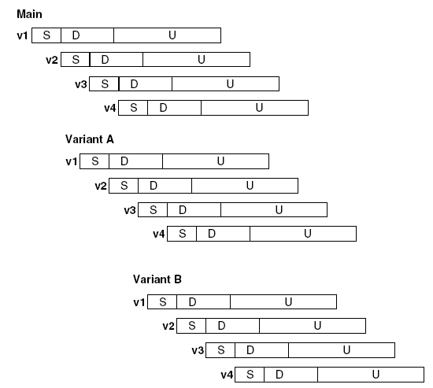

Slide 51
Multiple Products and Versions
From a requirements management point of view, each variant will have many requirements in common with the core product,
But it will have some requirements that are specific to that variant and therefore differentiate it from other variants.
On the other hand, there may be no different requirements for each version of a variant, because each version is an attempt to satisfy the same set of requirements.

Slide 52
Monitoring
Monitoring progress in a product organization uses exactly the same mechanisms as for the other organizations.
Progress can be measured based on the extent to which a desired state has been reached.

Slide 53
Monitoring
As a general rule such states can be measured in the following terms:
  whether new objects exist that will become targets for traceability links
  whether attribute values exist;
  whether the required review status exists;
  whether traceability links exist from one data set to others

Slide 54
Changes
The major additional factor is where several variants of a product have common requirements and a change proposal is raised against one or more of them.
The questions that must be answered are:
  will all the variants want to incorporate the change?;
  when will they want to incorporate it?

Slide 55
Changes
It is necessary that there are planned, deferred and incorporated states for each variant.
The change can only achieve the status of complete when all the variants have reached their individual “incorporated” state.

Slide 56
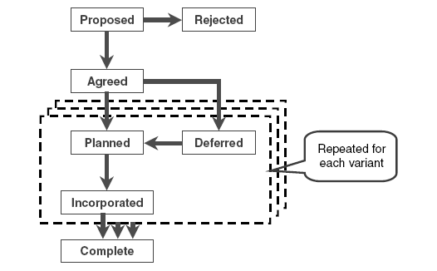

Slide 57
In summary, product organizations perform similar tasks to both acquisition and supplier organizations.
In addition, they must take care to control their
product portfolio so that an appropriate degree of commitment is made and the overall commercial exposure is acceptable.

